Slide 1






Important!! point all points P intersecting the plane Will be perpendicular to $\vec{Vp}$ so
$$\vec{Vp}·\vec{P_{p}P}=0$$
$$\vec{v_{p}}$$
P
$$\vec{P_{p}P}$$
$$\vec{P_{p}}$$
Li * Vi
Target consists to find Li
Screen
$$\vec{v_{i}}$$
z
$$\vec{P_{i}}$$
Pixel number i
O
y
X
Observer

Slide 2

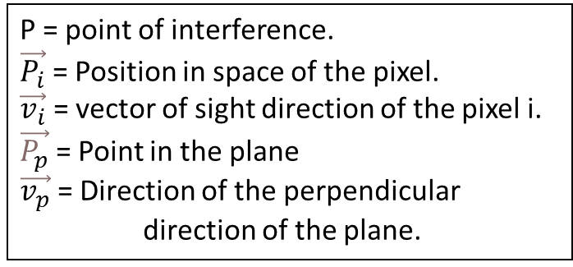
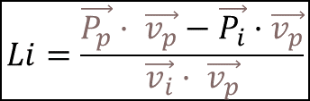


P = point of interference.
$\vec{P_{i}}$ = Position in space of the pixel.
$\vec{v_{i}}$ = vector of sight direction of the pixel i.
$\vec{P_{p}}$ = Point in the plane
$\vec{v_{p}}$ = Direction of the perpendicular direction of the plane.
$\vec{P}$ = $\vec{P_{i}}$ + Li * $\vec{v_{i}}$
$$\left(\vec{P} − \vec{P_{p}}\right)· \vec{v_{p}}=0$$
$$\left(\vec{P_{i}}\text{ + }\text{L}\text{i} \text{*} \vec{v_{i}}− \vec{P_{p}}\right)· \vec{v_{p}}=0$$
$$Li=\frac{\vec{P_{p}}· \vec{v_{p}}−\vec{P_{i}}·\vec{v_{p}}}{\vec{v_{i}}· \vec{v_{p}}}$$

Slide 3
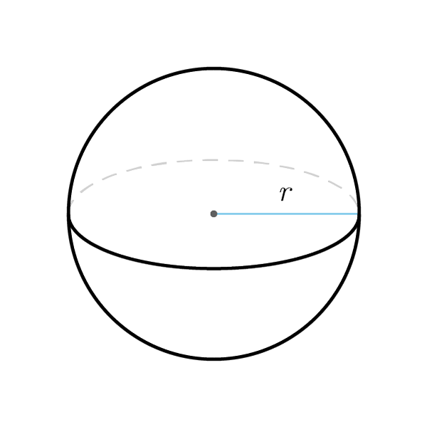
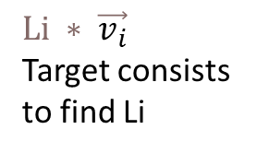





$$\vec{P_{1}}$$
$$\vec{P_{2}}$$
$$\vec{P_{r}}$$
$$Li ∗ \vec{v_{i}}$$
Target consists to find Li
Screen
$$\vec{v_{i}}$$
z
$$\vec{P_{i}}$$
Pixel number i
O
y
X
Observer

Slide 4



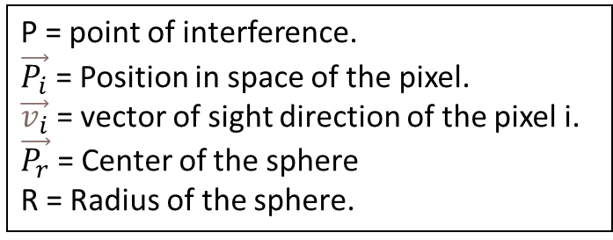

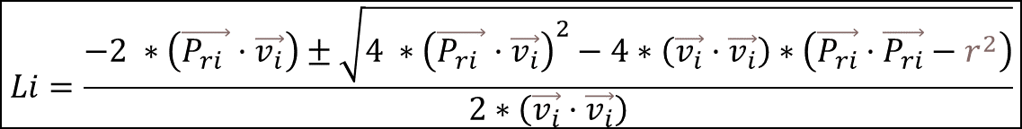


P = point of interference.
$\vec{P_{i}}$ = Position in space of the pixel.
$\vec{v_{i}}$ = vector of sight direction of the pixel i.
$\vec{P_{r}}$ = Center of the sphere
R = Radius of the sphere.
$$\vec{P_{n}}=\vec{P_{i}}\text{ + }\text{L}\text{i} \text{*} \vec{v_{i}}$$
$${\left\|\left(\vec{P_{i}}\text{ + }\text{L}\text{i} \text{*} \vec{v_{i}}− \vec{P_{r}}\right)\right\|}^{2}=r^{2}$$
$${\left\|\left(\vec{P_{n}}− \vec{P_{r}}\right)\right\|}^{2}=r^{2}$$
$${\left\|\left(\vec{P_{i}}− \vec{P_{r}}\text{+ }\text{L}\text{i} \text{*} \vec{v_{i}}\right)\right\|}^{2}=r^{2}$$
$$\vec{P_{ri}}$$
$${\left\|\left(\vec{P_{ri}} \text{+ }\text{L}\text{i} \text{*} \vec{v_{i}}\right)\right\|}^{2}=r^{2}$$
$$\vec{P_{ri}}·\vec{P_{ri}}+{Li}^{2 } ∗\left(\vec{v_{i}}·\vec{v_{i}}\right)+Li ∗2 ∗\left(\vec{P_{ri} }·\vec{v_{i}}\right)=r^{2}$$
$${Li}^{2 } ∗\left(\vec{v_{i}}·\vec{v_{i}}\right)+Li ∗2 ∗\left(\vec{P_{ri} }·\vec{v_{i}}\right)+ \vec{P_{ri}}·\vec{P_{ri}}−r^{2}=0$$
$$Li=\frac{−2 ∗\left(\vec{P_{ri} }·\vec{v_{i}}\right)±\sqrt{{4 ∗\left(\vec{P_{ri} }·\vec{v_{i}}\right)}^{2}−4∗\left(\vec{v_{i}}·\vec{v_{i}}\right)∗\left(\vec{P_{ri}}·\vec{P_{ri}}−r^{2}\right)}}{2∗\left(\vec{v_{i}}·\vec{v_{i}}\right)}$$

Slide 5
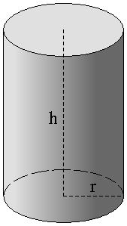
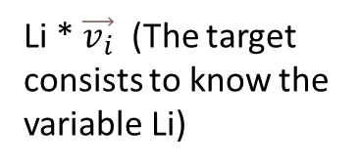




P1
r
r
P2
$$\vec{v_{c}}$$
Li * $\vec{v_{i}}$ (The target consists to know the variable Li)
$$\vec{P_{c}}$$
Screen
$$\vec{v_{i}}$$
z
$$\vec{P_{i}}$$
Pixel number i
O
y
X
Observer

Slide 6


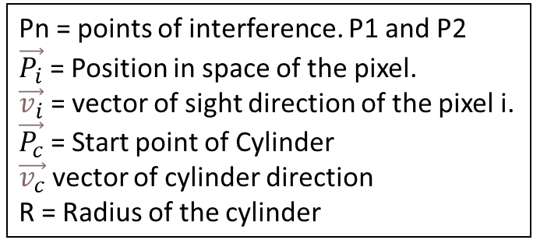
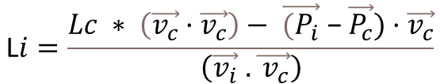




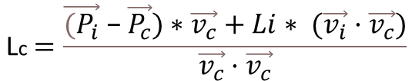



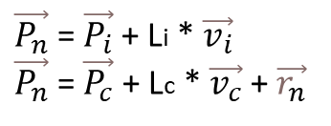
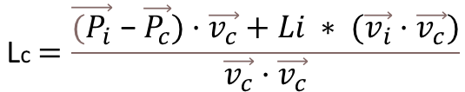

Pn = points of interference. P1 and P2
$\vec{P_{i}}$ = Position in space of the pixel.
$\vec{v_{i}}$ = vector of sight direction of the pixel i.
$\vec{P_{c}}$ = Start point of Cylinder
$\vec{v_{c}}$ vector of cylinder direction
R = Radius of the cylinder
$\vec{P_{n}}$ = $\vec{P_{i}}$ + Li * $\vec{v_{i}}$
$\vec{P_{n}}$ = $\vec{P_{c}}$ + Lc * $\vec{v_{c}}$+ $\vec{r_{n}}$
$\vec{P_{c}}$ + Lc * $\vec{v_{c}}$+ $\vec{r_{n}}$ = $\vec{P_{i}}$ + Li · $\vec{v_{i}}$
$\vec{r_{n}}$ = $\vec{P_{i}}$ + Li * $\vec{v_{i}}$ - $\vec{P_{c}}$ - Lc · $\vec{v_{c}}$
$\vec{r_{n}}$ · $\vec{v_{c}}$ = 0 (Vector $\vec{v_{c}}$ and vector radius are perpendicular)
0 = ($\vec{P_{i}}$ + Li * $\vec{v_{i}}$ - $\vec{P_{c}}$ - Lc * $\vec{v_{c}}$) · $\vec{v_{c}}$
$$\text{L}\text{c}=\frac{\vec{{(P}_{i}}\text{ − }\vec{P_{c}})·\vec{v_{c}}+Li ∗ (\vec{v_{i}}·\vec{v_{c}})}{\vec{v_{c}}·\vec{v_{c}}}$$
$$\text{L}i=\frac{Lc ∗ \left(\vec{v_{c}}·\vec{v_{c}}\right)− \vec{{(P}_{i}}\text{ − }\vec{P_{c}})·\vec{v_{c}}}{\left(\vec{v_{i}} .\vec{ v_{c}}\right)}$$
$\vec{r_{n}}$ = $\vec{P_{i}}$ + Li * $\vec{v_{i}}$ - $\vec{P_{c}}$ - Lc · $\vec{v_{c}}$
$\vec{r_{n}}$ = $\vec{P_{i}}$ + Li * $\vec{v_{i}}$ - $\vec{P_{c}}$ - $\frac{\vec{{(P}_{i}}\text{ − }\vec{P_{c}})·\vec{v_{c}}+Li ∗ (\vec{v_{i}}·\vec{v_{c}})}{\vec{v_{c}}·\vec{v_{c}}}$ · $\vec{v_{c}}$
$$\text{L}\text{c}=\frac{\vec{{(P}_{i}}\text{ − }\vec{P_{c}})∗\vec{v_{c}}+Li∗ (\vec{v_{i}}·\vec{v_{c}})}{\vec{v_{c}}·\vec{v_{c}}}$$
$\vec{r_{n}}$ = $\vec{{(P}_{i}}\text{ − }\vec{P_{c}})$- $\frac{\vec{{(P}_{i}}\text{ − }\vec{P_{c}})·\vec{v_{c}}}{\vec{v_{c}}·\vec{v_{c}}}$ · $\vec{v_{c}}$+ Li * $\vec{v_{i}}$ - $\left[\frac{ (\vec{v_{i}}·\vec{v_{c}})}{\vec{v_{c}}·\vec{v_{c}}}\right]$· $\vec{v_{c}}$
$$\vec{v_{1}}$$
$$\vec{v_{2}}$$
$\vec{r_{n}}$ = $\vec{v_{1}}$+ Li * $\vec{v_{2}}$
$\vec{r_{n}}·\vec{r_{n}}$= $\left(\vec{v_{1}}+\text{L}\text{i}\text{*}\vec{v_{2}}\right)·\left(\vec{v_{1}}+\text{L}\text{i}\text{ * }\vec{v_{2}}\right)$
$r^{2}= {\left\|\vec{r_{n}}\right\|}^{2}$= ${\left\|\vec{v_{1}}\right\|}^{2}$ +${\text{L}\text{i}}^{2}∗{\left\|\vec{v_{2}}\right\|}^{2}+2 ∗\text{L}\text{i} ∗$ $\left(\vec{v_{1}}\text{ · }\vec{v_{2}}\right)$
$$0 ={\text{L}\text{i}}^{2}∗{\left\|\vec{v_{2}}\right\|}^{2}+\text{Li} ∗2 ∗\left(\vec{v_{1}}\text{ · }\vec{v_{2}}\right)+ {\left\|\vec{v_{1}}\right\|}^{2}− r^{2}$$
$$Li= \frac{−2 ∗\left(\vec{v_{1}}\text{ · }\vec{v_{2}}\right)±\sqrt{{4 ∗\left(\vec{v_{1}}\text{ · }\vec{v_{2}}\right)}^{2}−4∗{\left\|\vec{v_{2}}\right\|}^{2}∗\left({\left\|\vec{v_{1}}\right\|}^{2}− r^{2}\right)}}{2a}$$

Slide 7
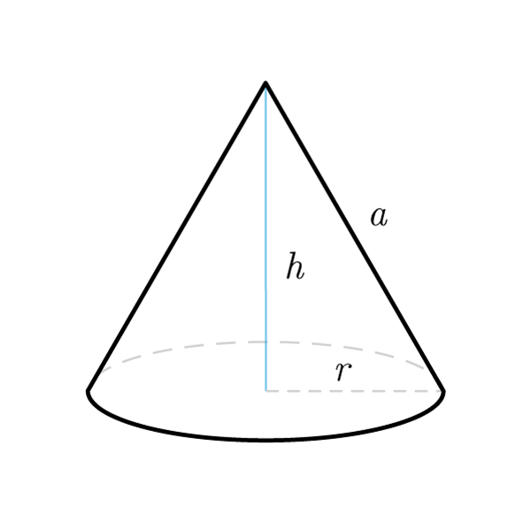





P1
r1
r2
P2
$$\vec{v_{c}}$$
Li * $\vec{v_{i}}$ (The target consists to know the variable Li)
$$\vec{P_{c}}$$
Screen
$$\vec{v_{i}}$$
z
$$\vec{P_{i}}$$
Pixel number i
O
y
X
Observer

Slide 8


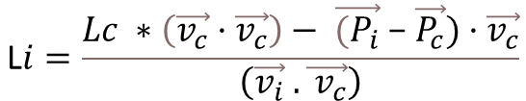
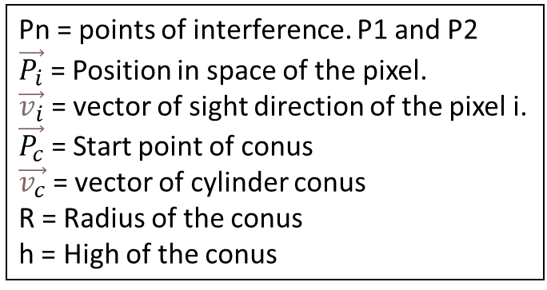


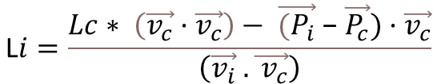
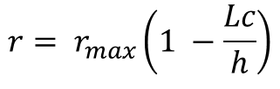
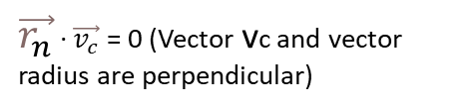




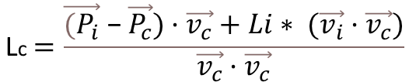

Pn = points of interference. P1 and P2
$\vec{P_{i}}$ = Position in space of the pixel.
$\vec{v_{i}}$ = vector of sight direction of the pixel i.
$\vec{P_{c}}$ = Start point of conus
$\vec{v_{c}}$ = vector of cylinder conus
R = Radius of the conus
h = High of the conus
$\vec{P_{n}}$ = $\vec{P_{i}}$ + Li * $\vec{v_{i}}$
$\vec{P_{n}}$ = $\vec{P_{c}}$ + Lc * $\vec{v_{c}}$+ $\vec{r_{n}}$
$\vec{P_{c}}$ + Lc * $\vec{v_{c}}$+ $\vec{r_{n}}$ = $\vec{P_{i}}$ + Li * $\vec{v_{i}}$
$\vec{r_{n}}$ = $\vec{P_{i}}$ + Li * $\vec{v_{i}}$ - $\vec{P_{c}}$ - Lc * $\vec{v_{c}}$
$\vec{r_{n}}$ · $\vec{v_{c}}$ = 0 (Vector vc and vector radius are perpendicular)
0 = ($\vec{P_{i}}$ + Li * $\vec{v_{i}}$ - $\vec{P_{c}}$ - Lc * $\vec{v_{c}}$) · $\vec{v_{c}}$
$$\text{L}\text{c}=\frac{\vec{{(P}_{i}}\text{ − }\vec{P_{c}})·\vec{v_{c}}+Li∗ (\vec{v_{i}}·\vec{v_{c}})}{\vec{v_{c}}·\vec{v_{c}}}$$
$$\text{L}i=\frac{Lc∗ \left(\vec{v_{c}}·\vec{v_{c}}\right)− \vec{{(P}_{i}}\text{ − }\vec{P_{c}})·\vec{v_{c}}}{\left(\vec{v_{i}} .\vec{ v_{c}}\right)}$$
$\vec{r_{n}}$ = $\vec{P_{i}}$ + Li * $\vec{v_{i}}$ - $\vec{P_{c}}$ - Lc * $\vec{v_{c}}$
$$\text{L}i=\frac{Lc ∗\left(\vec{v_{c}}·\vec{v_{c}}\right)− \vec{{(P}_{i}}\text{ − }\vec{P_{c}})·\vec{v_{c}}}{\left(\vec{v_{i}} .\vec{ v_{c}}\right)}$$
$\vec{r_{n}}$ = $\vec{P_{i}}$ + $\frac{Lc ∗ \left(\vec{v_{c}}·\vec{v_{c}}\right)− \vec{{(P}_{i}}\text{ − }\vec{P_{c}})·\vec{v_{c}}}{\left(\vec{v_{i}} .\vec{ v_{c}}\right)}$ · $\vec{v_{i}}$ - $\vec{P_{c}}$ - Lc * $\vec{v_{c}}$
$\vec{r_{n}}$ = $\vec{{(P}_{i}}\text{ − }\vec{P_{c}})$- $\frac{\vec{{(P}_{i}}\text{ − }\vec{P_{c}})·\vec{v_{c}}}{\left(\vec{v_{i}} .\vec{ v_{c}}\right)}$ · $\vec{v_{i}}$+ $Lc ∗\left(\left[\frac{ \left(\vec{v_{c}}·\vec{v_{c}}\right)}{\left(\vec{v_{i}} .\vec{ v_{c}}\right)}\right] ·\vec{v_{i}}− \vec{v_{c}}\right)$ = $\vec{v_{1}}$+ Lc $\vec{v_{2}}$
$$\vec{v_{1}}$$
$$\vec{v_{2}}$$
$${r= r}_{max}\left(1 −\frac{Lc}{h}\right)$$
$\vec{r_{n}}·\vec{r_{n}}$= $\left(\vec{v_{1}}+\text{L}\text{c}\text{ · }\vec{v_{2}}\right)·\left(\vec{v_{1}}+\text{L}\text{c}\text{ · }\vec{v_{2}}\right)$
$\vec{r_{n}}$ = $\vec{v_{1}}$+ Lc $\vec{v_{2}}$
$r^{2}= {\left\|\vec{r_{n}}\right\|}^{2}{\text{= }\left({ r}_{max}\left(1 −\frac{Lc}{h}\right)\right)}^{2}$ = ${\left\|\vec{v_{1}}\right\|}^{2}$ +${\text{L}c}^{2}∗{\left\|\vec{v_{2}}\right\|}^{2}+2 ∗\text{L}\text{c} ∗$ $\left(\vec{v_{1}}\text{ · }\vec{v_{2}}\right)$

Slide 9
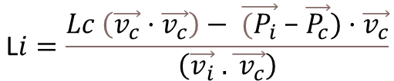
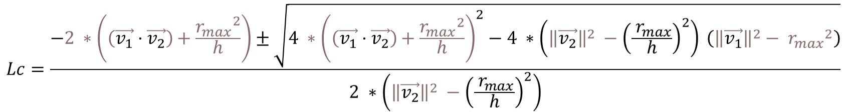

$$0 ={\text{L}\text{c}}^{2}∗\left({\left\|\vec{v_{2}}\right\|}^{2} −{\left(\frac{{ r}_{max}}{h}\right)}^{2}\right)+\text{L}\text{c} ∗2 ∗\left(\left(\vec{v_{1}}\text{ · }\vec{v_{2}}\right)+\frac{{r_{max}}^{2}}{h}\right)+ {\left\|\vec{v_{1}}\right\|}^{2}− {r_{max}}^{2}$$
2nd order ecuation to solve Lc
a
b
$$c$$
$$Lc=\frac{−2 ∗\left(\left(\vec{v_{1}}\text{ · }\vec{v_{2}}\right)+\frac{{r_{max}}^{2}}{h}\right)±\sqrt{{4 ∗\left(\left(\vec{v_{1}}\text{ · }\vec{v_{2}}\right)+\frac{{r_{max}}^{2}}{h}\right)}^{2}−4 ∗\left({\left\|\vec{v_{2}}\right\|}^{2} −{\left(\frac{{ r}_{max}}{h}\right)}^{2}\right) \left({\left\|\vec{v_{1}}\right\|}^{2}− {r_{max}}^{2}\right)}}{2 ∗\left({\left\|\vec{v_{2}}\right\|}^{2} −{\left(\frac{{ r}_{max}}{h}\right)}^{2}\right)}$$
$$\text{L}i=\frac{Lc \left(\vec{v_{c}}·\vec{v_{c}}\right)− \vec{{(P}_{i}}\text{ − }\vec{P_{c}})·\vec{v_{c}}}{\left(\vec{v_{i}} .\vec{ v_{c}}\right)}$$

